Slide 1

“An Impact Study of Noise on Reversible Data hiding with Controlled Contrast Enhancement” Department of Electronics & Communication Engineering
BATCH:4
Project Associates
N. Sireesha(19K61A04A5)
K. Rakshita(19K61A0485)
G. K. Ram Kumar(19K61A0463)
K. Hari Charan(19K61A0474)
Under the Guidance of
Mr. M. Ravi Shankar
Assistant Professor

Slide 2
Contents:
Abstract
Introduction
Literature Survey
Statement of problem
Objective
Methodology
Block Diagram
Features of project
Software implementation
Experimental Results
Comparison with existing system
Conclusion and future scope
References

Slide 3
Abstract:
Data hiding concepts has various applications in the field of ownership protection, telemedicine, secret communication and content authentication.
“Reversible data hiding” using IWT and histogram shifting is a method in which a secret message is embedded into the created slots of histogram peaks.
Recovering original information by eliminating various noise attacks is a major challenge.
In this project ,we analyze effects of noise attacks while data hiding.
Remove them efficiently with the help of appropriate filtering technique.
The performance is evaluated by considering PSNR,SSIM, and RMS as performance metrics.

Slide 4
Introduction:
In the world of growing information technology, security of data is always a vital concern.
Providing system security alone is not sufficient but provide security to information using data hiding is also important.
The well known data hiding method is the least significant bit substitution.
But this method is irreversible method of data hiding.
In some applications like medical imaging and military imaging that is a small loss may lead to drastical change.

Slide 5
We propose an efficient reversible data hiding method based on histogram shifting technique.
It is used widely because it has ability to restore the host image.
The proposed method can accurately recover the original image and extract the hidden data accurately.
The two peak points in the histogram are selected for data embedding.

Slide 6
The proposed scheme provides better payload capacity and good visual perception with the help of controlled contrast enhancement(CCE).
After embedding the secret information ,embedding image subjected to various attacks and the robustness of the proposed scheme is tested.

Slide 7
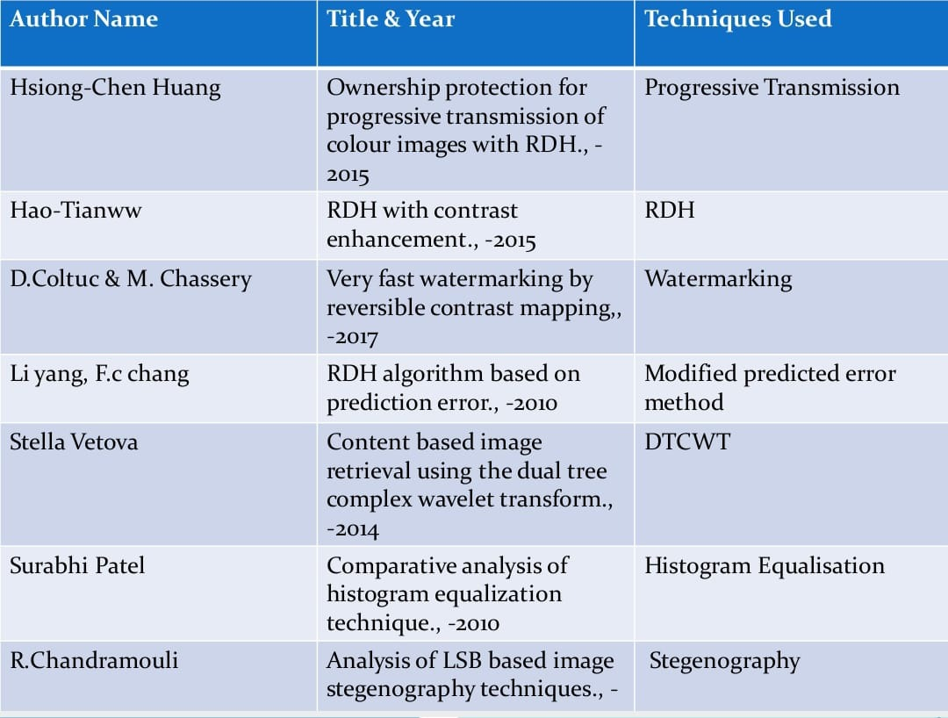
Background

Slide 8
Literature survey
Hao-Tian Wu[1] proposed reversible data hiding algorithm for digital images.
The proposed algorithm enhance the contrast of a host image to improve its visual quality.
It is the first algorithm that achieves image contrast enhancement by RDH.

Slide 9
D. Coltus[2]proposed reversible contrast mapping
It providing high data embedding bit-rate at a very low mathematical complexity.
It provide almost the same bit-rate as the difference expansion and its extensions.
In terms of mathematical complexity, the proposed reversible watermarking appears as being the lowest complexity

Slide 10
Problem Statement
“Reversible data hiding” is a technique proposed to provide security to the secret inforation for the purpose of confidentiality.
Not only embedding the secret data but also extracting it with high accuracy by eliminating the noise effect is the significant problem of concern.

Slide 11
objective
The main objective of the project is to recover the original image and extract the hidden data accurately and also improve the accuracy of the performance metrics.

Slide 12
Methodology
To recover the original image and extract the hidden data accurately. After the process of hiding add different types of noise attacks on the host image.
To get the original image remove those attacks on the watermarked image and also improve the performance metrics.

Slide 13
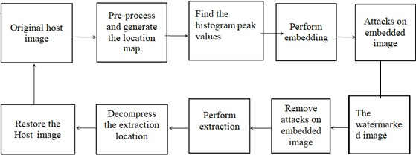
Block Diagram

Slide 14
Features of Project
The entire project is implemented in software so this has negligible hardware cost and it is less expensive .
The implemented design can accurately recover the original image and extract the given data accurately and it improves the performance of PSNR, SSIM and RMS.

Slide 15
Design
To hide and corrupt the original information of the host image.
Measure the corrupted information and also recover the original image and extract the hidden data accurately.
To measure the error by using
Error=sum/ (im*in)
where im, in=size of watermarked image

Slide 16
To find the performance metrics of the image i.e PSNR,RMS and SSIM.
For PSNR = 20*log10(255/RMS)
Where RMS = Sqrt(error)
To calculate SSIMVAL
SSIMVAL= SSIM (original image, watermarked image)

Slide 17
Software Implementation
The implementation of the project is done in MATLAB software.
Select the host image.
Generate the location
Generate the histogram of the host image
Check whether CCE exceed the level of threshold
Embedding secret information on LSB of two peak points
Attacks are occur on embedded image.
Perform de-embedding iteratively.
Extract the secret information on the host image.

Slide 18
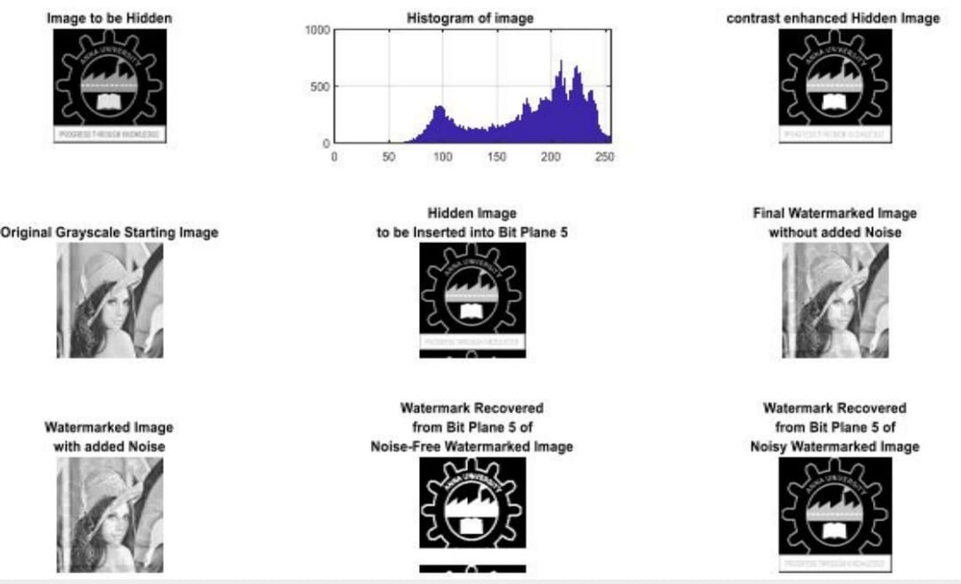
Experimental Result

Slide 19
Performance metrics
PSNR = 27.0512
RMS = 11.3235
SSIM = 0.8017
ERROR = 128.2221

Slide 20
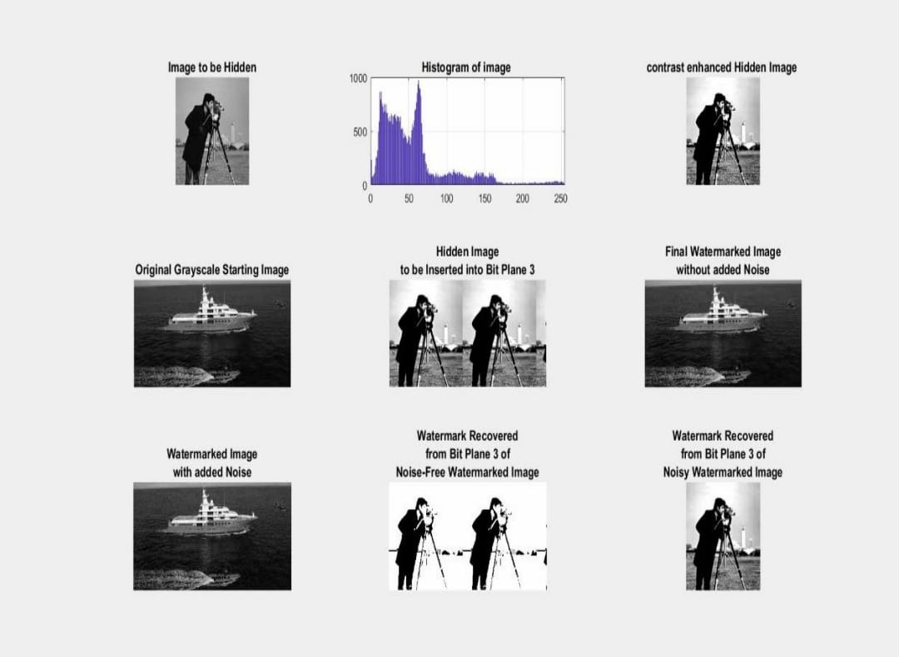

Slide 21
Cont..
PSNR = 39.0953
RMS = 2.8299
SSIM = 0.9751
ERROR = 8.0086

Slide 22
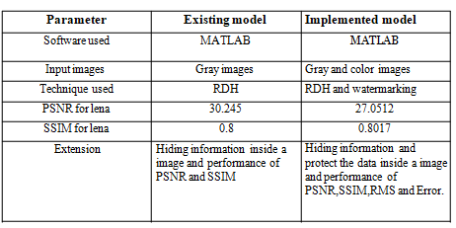
Comparison with existing system

Slide 23
Conclusion
An efficient data hiding method using histogram shifting is presented.
In this work, embedding operation is performed based on histogram shifting, this can embed significantly more data.
For high payloads, image is over-enhanced which introduces annoying contrast; it can be controlled by CCE method.
The robustness of the proposed algorithm is verified using various attacks.
The cover image as well as the embedded bits is exactly recovered from the embedded image with better visual quality.
Experimental results in terms of PSNR, SSIM, RMS and data corruption is significantly demonstrating the better performance.

Slide 24
Future Scope
This project is helpful for military imaging, secret communication and telemedicine.
To improve the security of the present data hiding algorithms.
This was achieved using histogram before embedding the data in the cover image and also apply watermarking on the image to protect the data.
The robustness of the proposed algorithm is verified using various attacks.
The cover image as well as the embedded bits is exactly recovered from the embedded image with better visual quality.
To improve the accuracy of PSNR, SSIM and RMS of recovered noisy image.

Slide 25
References
[1] HsiangCheh Huang, Jiun Lin, Yuh-Yih Lu, “Ownership Protection for Progressive Transmission of Color Images with Reversible Data Hiding” ,2015.
[2] Hao-Tian Wu, Jean-Luc Dugelay, and Yun-Qing Shi, “Reversible Image Data Hiding with Contrast Enhancement”, IEEE SIGNAL 2015.PROCESSING LETTERS, VOL. 22.
[3] D.Coltuc and M. Chassery, “Very fast watermarking by reversible contrast mapping”, IEEE Signal Process. Lett., vol.14,no.4,pp. 255–258 2007.
[4] Li Yang, F.C. Chang, and Yu Jing, “Reversible Data Hiding Algorithm Based on Prediction Error”, IEEE Trans. Consumer Electron.,vol. 53, no.2, pp. 629–636, 2010.
[5] R. Chandramouli and Nasir Memon, “Analysis of LSB based image steganography techniques”, In Image Processing Proceedings 2001 International Conference on, IEEE, vol. 3, pp. 1019-1022, 2001

Slide 26
References
[6] Surabhi Patel and Mausumi Goswami “ Comparitive Analysis of Histogram Equalization Techniques,” IEEE Transaction on consumer Electronics vol 52,November 2010.
[7] Stella Vetova and Ivan Ivanov, “Content Based Image Retrieval Using The Dual- Tree Complex Wavelet Transform”,2014.
[8] B. S. Manjunath, Jens-Rainer Ohm, Vinod V. Vasudevan and Akio Yamada,” Color and Texture Descriptors”, IEEE transactions on circuits and systems for video technology, VOL. 11, NO. 6, JUNE 2001.
[9] C. W. Honsinger, P. W. Jones, M. Rabbani, and J. C. Stoffel, “Lossless recovery of an original image containing embedded data,” U.S. Patent6278 791, 2001.

Slide 27


